Slide 1

NEST 2.0 HACKATHON 2026
NEST 2.0
Unified Clinical Intelligence
Platform
Revolutionizing Clinical Trials with Agentic AI & Global Anomaly Detection
Team Name : Data Morphers
Agentic AI
Global Intelligence
Predictive Safety

Slide 2
01
The Why Now?
The Crisis of Complexity in Clinical Trials
The Context
The Gap
Current tools are "Reactive" (reporting what happened last month) and "Siloed" (Study A doesn't learn from Study B).
A typical pharma company runs 20+ parallel studies simultaneously. Data is exploding across every trial—EDC metrics, safety reports, Whodrug coding, lab results, adverse events—all trapped in disconnected Excel files and siloed databases.
Our Vision
20+
100K+
NEST 2.0: A "Global Intelligence" engine that stitches every study together to predict risks before they happen.
Parallel Studies
Data Points/Day
Current State vs NEST 2.0
Disconnected
Data
Reactive
Reporting
Unified
Intelligence
Predictive
Insights

Slide 3
02
The Problem
"You Can't Fix What You Can't See"
Two critical failures in current clinical data management
Problem 1: Fragmentation
Problem 2: The "Hiding" Signal
The Naming Nightmare
Invisible Safety Signals
Study 1 calls it "Region", Study 2 calls it "Reg", Study 3 calls it "Geographic_Area".
A safety signal might appear 2 times in Study A and 2 times in Study B.
The same data lives under different names across studies.
Individually, they look fine. Globally, it's a cluster.
Real Impact:
Real Impact:
Merging these manually takes weeks of manual effort, delaying analysis and creating human error.
Critical safety patterns remain invisible until it's too late.
2
2
4
Site_ID
SiteNumber
Site #
Study A
Study B
Global Signal
Current State: Manual Excel checks, missed deadlines, reactive FDA findings
Teams spend weeks on manual data cleaning, often missing critical patterns. This reactive approach leads to missed deadlines, costly delays, and FDA findings that could have been prevented. You can't fix what you can't see.

Slide 4
03
The Solution
NEST 2.0: A Unified "Clinical Data Lake"
Agentic pipelines that autonomously ingest, harmonize, and analyze data from any source
1
Schema-Agnostic Ingestion
2
Unsupervised ML
3
Gen AI Safety
Drop raw files → Auto-Mapping → Global Dataset. NEST 2.0's agentic pipelines automatically handle any data format, eliminating manual mapping.
Detecting anomalies without needing labelled "bad data". NEST 2.0 uses Isolation Forest to learn what 'normal' looks like across your entire portfolio.
Finding patterns, not just keywords. NEST 2.0's Gen AI engine understands medical semantics to discover hidden safety signals.
Accepts any file structure (CSV, Excel, JSON, XML)
No pre-labelled training data required
Semantic expansion for medical synonyms
Intelligent field mapping & semantic harmonization
Learns global patterns across all studies
Pattern discovery beyond simple search
Zero configuration required
Identifies statistically improbable behavior
Cross-study signal aggregation
Impact
Model
Engine
From weeks to minutes
Isolation Forest
Agentic Discovery
NEST 2.0 Data Flow Architecture
Raw Files
Harmonize
Analyze
Insights

Slide 5
04
Innovation 1
Smart Ingestion: The "Calamine" Edge
Breaking the Speed & Schema Barrier
Speed
Deep Scan
Semantic Harmonization
500k+ rows/sec
100% File Coverage
Fuzzy Logic Mapping
Python + Rust Calamine Engine achieves unprecedented performance, processing massive datasets in seconds.
We removed "Top 1000 row" limits. NEST scans every row to find buried safety codes.
"Fuzzy Logic" automatically maps variations to a single master key.
Standard (pandas)
~5 mins
Site_ID → Site
Standard Scan
1,000
SiteNumber → Site
NEST 2.0
~2 secs
NEST Deep Scan
500,000+
Site # → Site
Tech Stack
Performance Gain
Python + Rust (Calamine Engine)
150x faster than traditional methods

Slide 6
05
Innovation 2
Global Intelligence Layer
Training on the Entire Portfolio
The Shift
The Methodology
New Paradigm
1
Train on All 23 Studies
Moving from "Study-Specific" to "Portfolio-Wide" Learning. Instead of training models on individual studies, NEST 2.0 trains on all studies simultaneously.
The model learns patterns across the entire portfolio, understanding global norms.
2
Learn Global "Normal"
The model builds a comprehensive baseline, distinguishing true anomalies from study-specific noise.
The Model
Isolation Forest
3
Flag Mathematically Weird Sites
Unsupervised Anomaly Detection learns what "Normal" looks like globally, then flags deviations.
Sites with unusual patterns (e.g., high queries but low missing data) are flagged, even if they look fine in isolation.
Key Advantage:
No labelled "bad" data required. The model learns normal behavior and flags statistical outliers.
The Result: Unprecedented Visibility
NEST 2.0 flags sites that are "mathematically weird" — sites that might look fine in an Excel filter but are statistical outliers when viewed through a global lens.
What This Means
Global context matters. A site might look normal in isolation, but when compared to 22 other studies, patterns emerge. NEST 2.0 provides this missing context.

Slide 7
06
Innovation 3
Safety Signal Intelligence
Gen AI & Medical Pattern Discovery
The "Headache" Problem
Our Solution
Keyword Search Fails
Agentic Discovery Engine
Searching for "Headache" misses"Migraine", "Cephalgia", "Head Pain" — medically related terms that should be grouped.
NEST 2.0's Gen AI engine understands medical semantics and automatically discovers related patterns across studies.
Current Gap:
Semantic Expansion
Statistical Heatmaps
Cross-Study Discovery
Standard keyword search has zero medical intelligence. It can't find what it doesn't know to look for.
Auto-searches for medical synonyms and related concepts.
Visualizes density to reveal hidden clusters.
Finds patterns across studies.
Semantic Intelligence in Action
H
M
C
HP
Headache
Migraine
Cephalgia
Head Pain
Direct match
Auto-detected
Medical synonym
Related concept
Impact: Found safety signals in Studies 10 & 11 that were missed by standard keyword search.

Slide 8
07
Operational Impact
From Data to Actionable Insights
The NEST 2.0 Dashboard: Visualizing Risk in Real-Time
Visualizing Risk
Automation
Global Risk Map
CSR Narrative Generator
A live heatmap of Country/Region performance. Red zones = high risk requiring immediate attention.
Auto-writes regulatory explanations using ML findings. From data to compliant narrative in seconds.
Site Drill-Down
Push Simulator
Click any site to see exactly why it was flagged (e.g., "3x Average Query Volume"). Instant root cause analysis.
One-click notifications to investigators at high-risk sites. Proactive communication before issues escalate.
Dashboard in Action
23
7
~3 hrs
100%
Studies Monitored
High-Risk Sites
Time Saved/Day
Issues Found

Slide 9
08
Feasibility & Future Roadmap
Production Ready & Scalable
From Hackathon Prototype to Enterprise Reality
Feasibility
Roadmap
NEST 2.0 is not just a concept — it's a working prototype tested and validated on real-world data.
From Hackathon to Reality: A clear path to production deployment.
1
Phase 1: Core Platform
DONE
Global Ingestion & ML Anomaly Detection
Local-First & Private
2
Phase 2: Conversational AI
Runs 100% offline. Zero PII leaves the laptop. Full compliance with data privacy regulations.
LLM Chat Interface: "Hey NEST, which sites are struggling?"
Universal Compatibility
3
Phase 3: Live Integration
Tested on 23 diverse datasets with 100% success rate. Schema-agnostic design ensures broad compatibility.
Real-time integration with Veeva/Rave EDC APIs
NEST 2.0 is Ready
23
100%
0
A working prototype solving real problems. The future of clinical trials is predictive, unified, and intelligent.
Studies Tested
Success Rate
PII Leaks

Slide 10
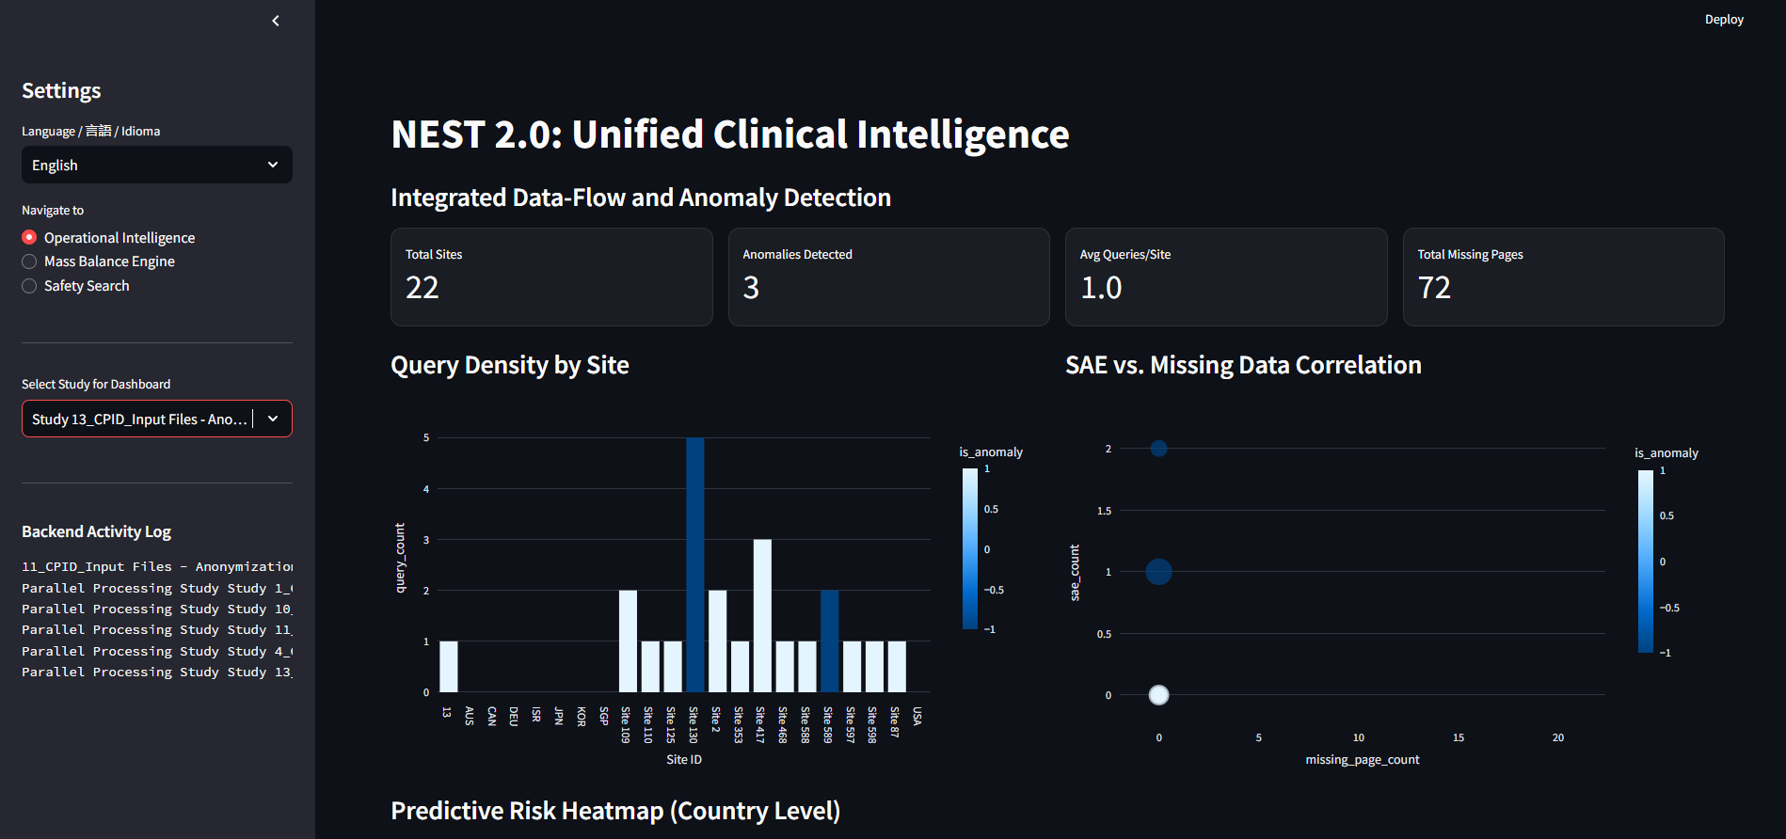
09
Live App Preview : https://uciplatform.streamlit.app/
GitHub : https://github.com/25CD3014/Unified-Clinical-Intelligence-Platform

Slide 11
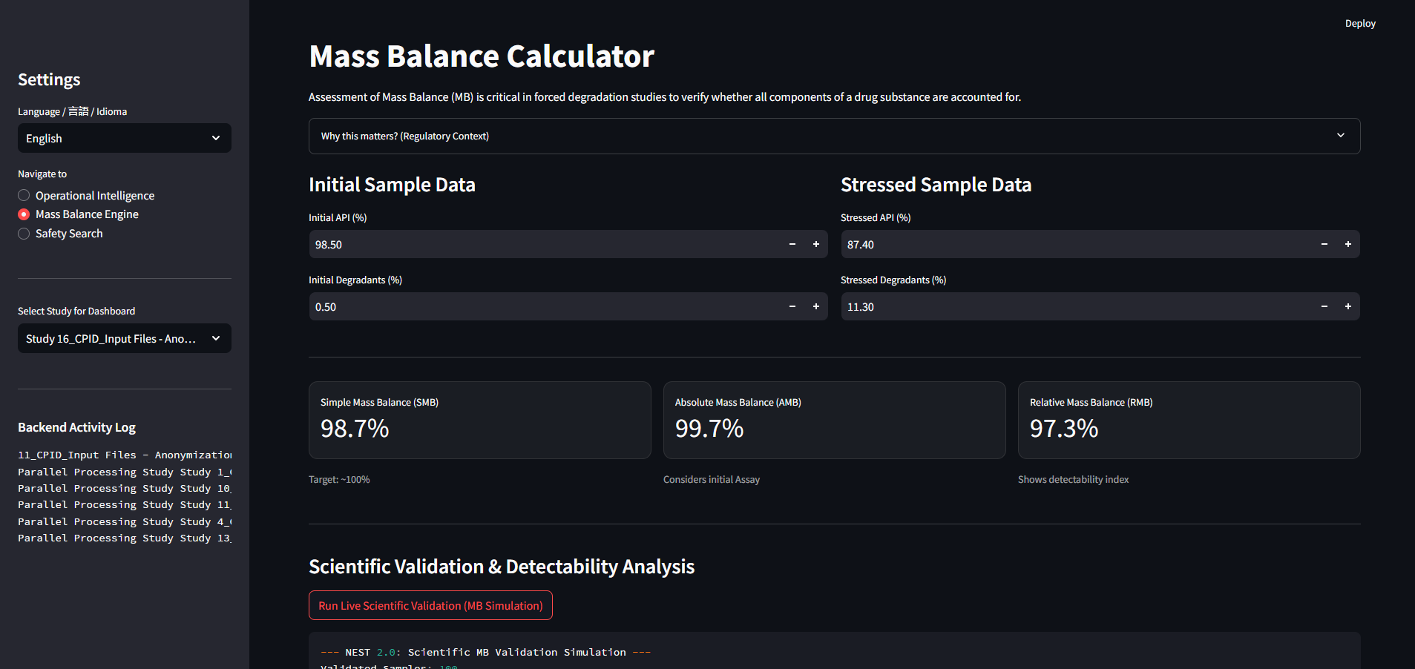
10
Live App Preview : https://uciplatform.streamlit.app/
GitHub : https://github.com/25CD3014/Unified-Clinical-Intelligence-Platform

Slide 12
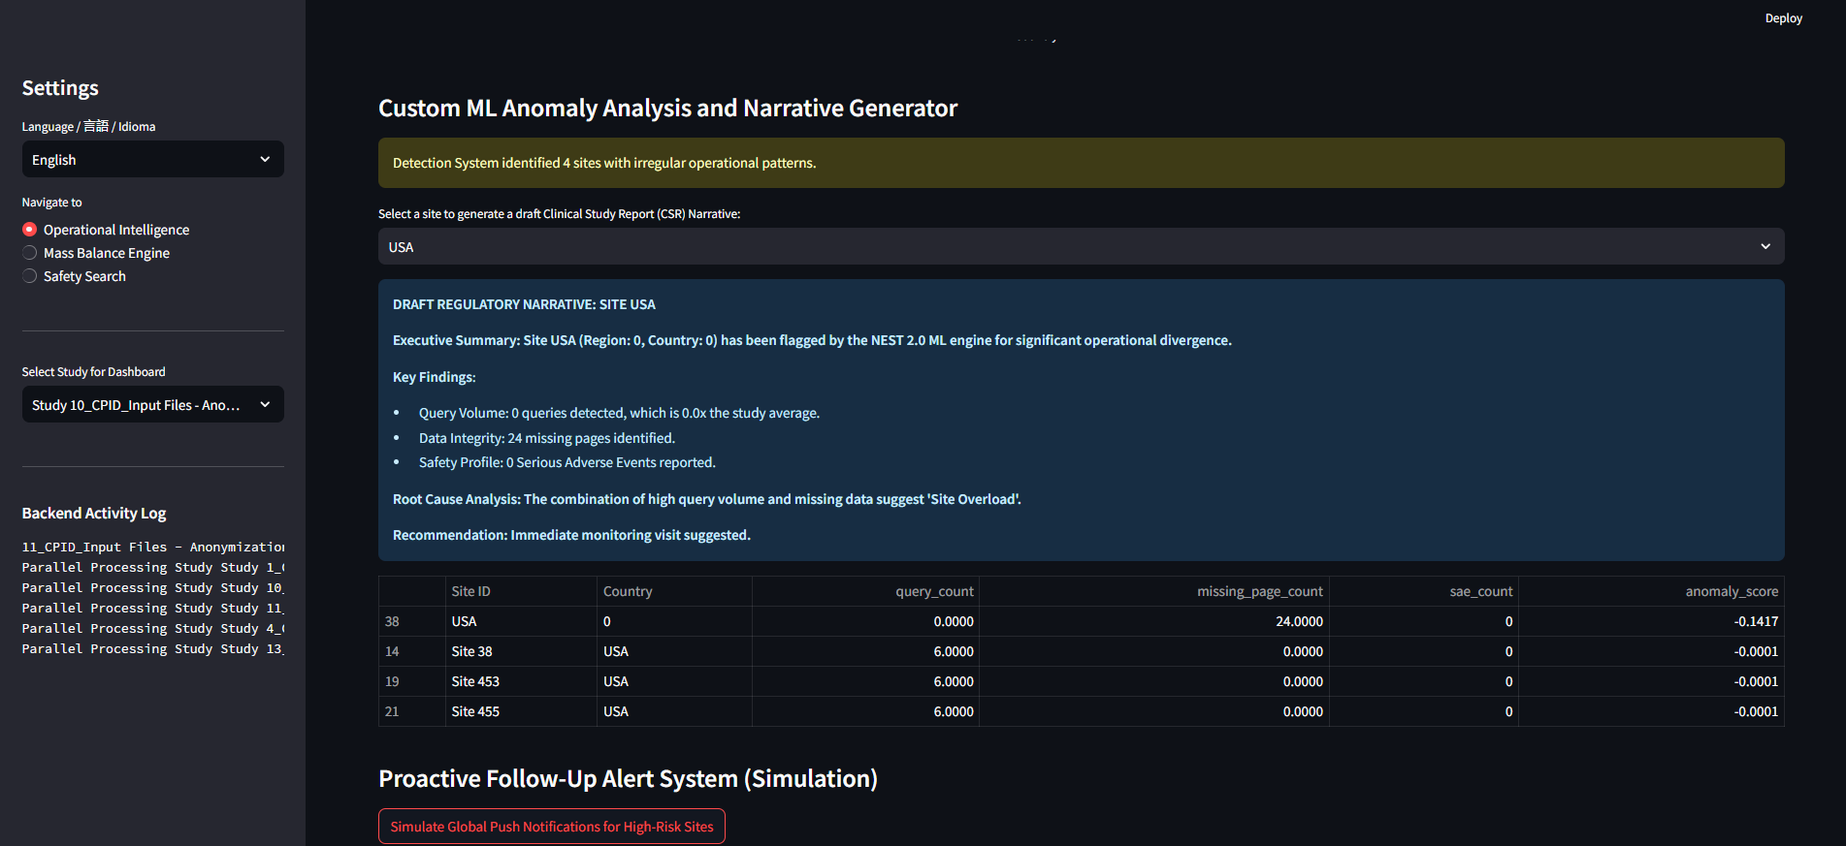
11
Live App Preview : https://uciplatform.streamlit.app/
GitHub : https://github.com/25CD3014/Unified-Clinical-Intelligence-Platform

Slide 13

NEST 2.0
Clinical Intelligence,
Redefined
The future of clinical trials is predictive, unified, and intelligent.
Agentic AI
Global Intelligence
Predictive Safety
Autonomous pipelines that learn and adapt
Portfolio-wide learning and pattern discovery
Finding risks before they become problems
Thank You

